Slide 1
Data Mining
COL 761

Slide 2
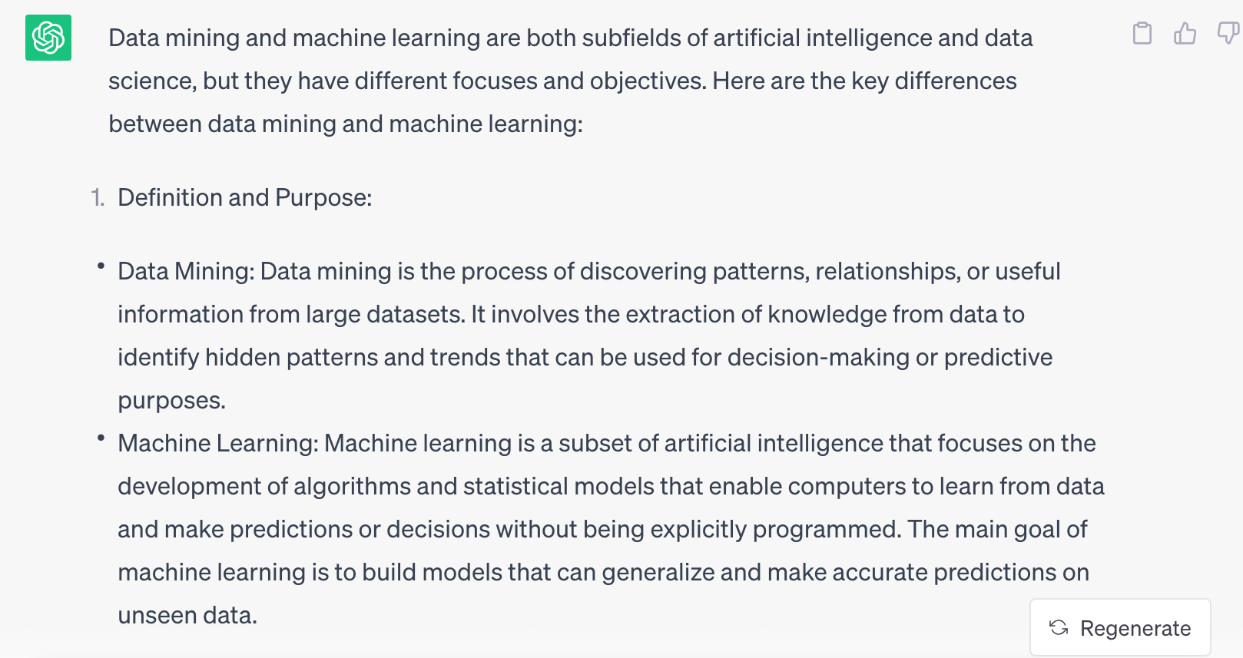

What is data mining? How is it different from Machine Learning?

Slide 3
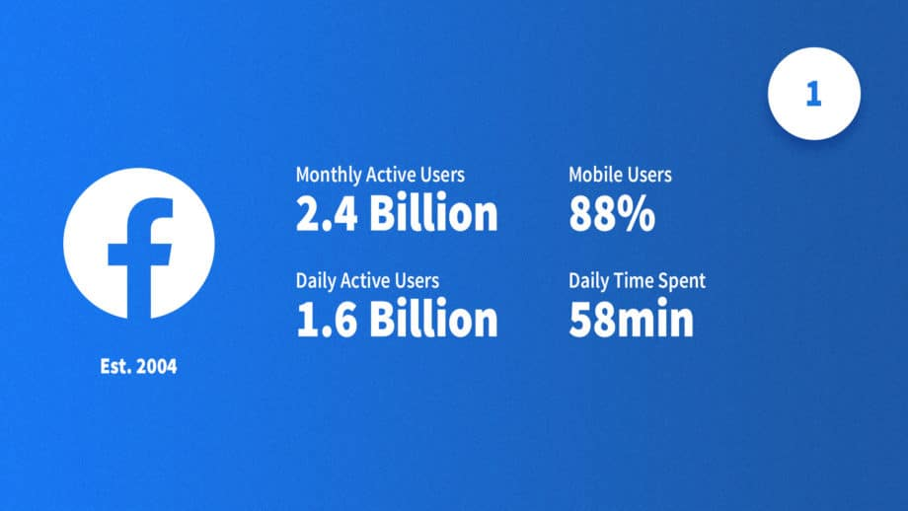
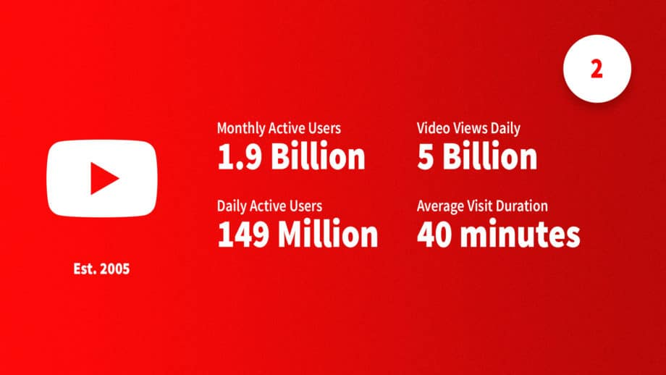
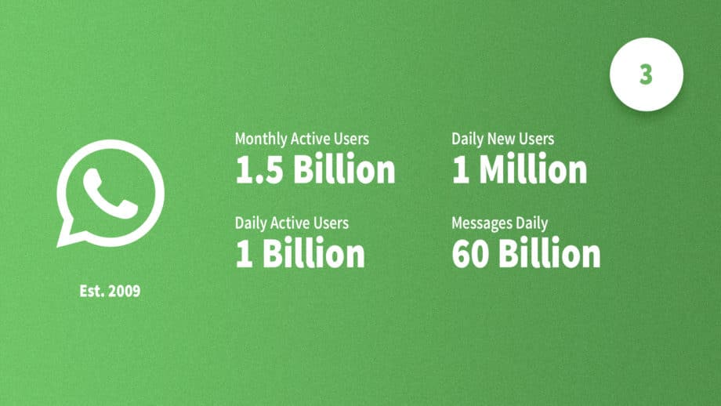
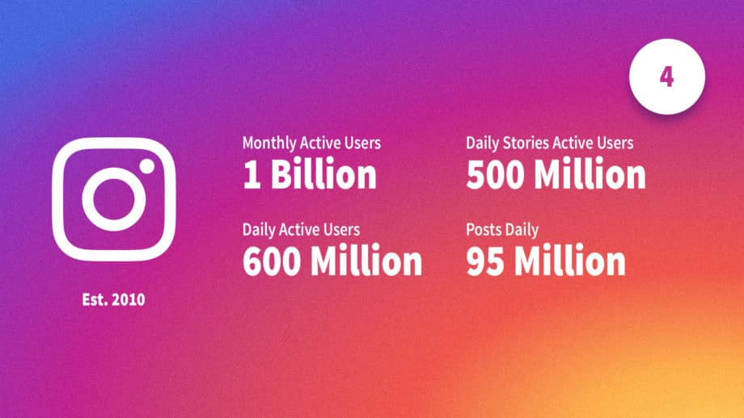
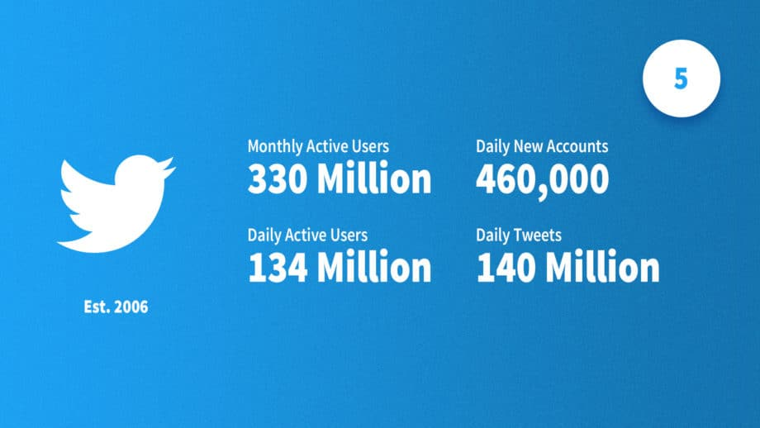
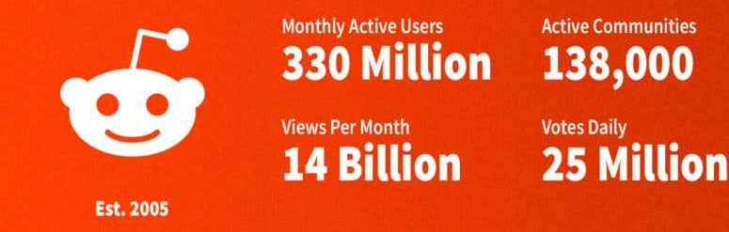
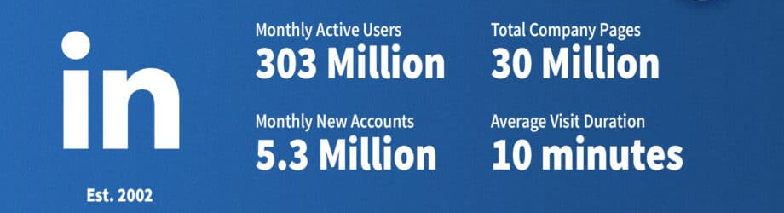
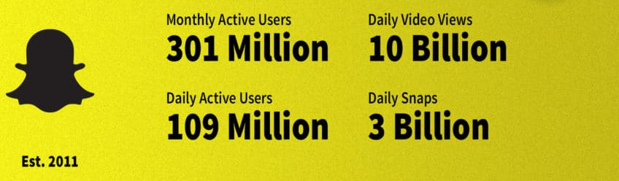
The need to scale

Slide 4
Data Mining
Data mining overlaps with:
Databases: Large-scale data, simple queries
Machine learning: Small data, Complex models
CS Theory: Algorithms
CS Theory
Machine Learning
Data Mining
Databases

Slide 5
What you will learn in this course..
Association rule mining (Frequent itemset mining)
Frequent subgraph mining
Searching and Indexing
Clustering
Random walks and PageRank
Deep Learning for graphs
Mining data streams
Anomaly detection
Other topics (depending on time left)

Slide 6
Grading
Homeworks: 60%
3-4
Midterm: 20%
Final: 20%
Audit Criteria:
40% or better

Slide 7
Homework
Will involve high amount of coding
Start early!
Plagiarism= Negative of the full assignment marks
You will handle large datasets
No extension of deadlines for degradation of health of
Your computer
Your family members
Your friends
Everyone starts with a bank of 5 buffer days
You can use it for any of the homeworks
No extensions if buffer days are exhausted.

Slide 8
Course material
Slides
Available in Teams
No textbook
Reference books
“Mining of Massive Datasets”, Ullman, Rajaraman, Leskovec
Available online
“Data Mining: Concepts and Techniques” by Han
“Introduction to Data Mining” by Tan, Steinbach, Kumar
Papers from conferences and journals

Slide 9
TAs
Anjali
Mridul Gupta
Burouj Armgaan
Tanishq Dubey
Shweta Mahajan

Slide 10
Scheduling
Classes till 11th^{th} August to be held online.
Class schedules will be announced on Teams/Piazza
Next class: tomorrow, same time.
In person classes to resume from the following week.

Slide 11
HW0
Get HPC and/or Baadal access
Form teams of 3.
Create a github repo for your team of 3
All assignments solutions to be uploaded to this repo.
Turn on notification for all threads in the Microsoft Teams COL 761
No excuses will be tolerated that you did not see a particular announcement
Marks: 10

Slide 12
Questions??
Class is full. No further seats.
Many students typically drop after first week. Keep an eye out vacancies arising due to some students dropping out.

